Slide 1


Slide 2
Solution focused brief therapy
Solution focused brief therapy is a type of therapy that helps a person under the current and future circumstances with also the goals but it does not relay on the past experiences. In this therapy the problems that makes client visit a therapist are not tackled but the therapist help the clients to vision the future and look for proper ways to become successful.
It involves helping the clients identify and develop skills that can help them achieve a vision set.

Slide 3
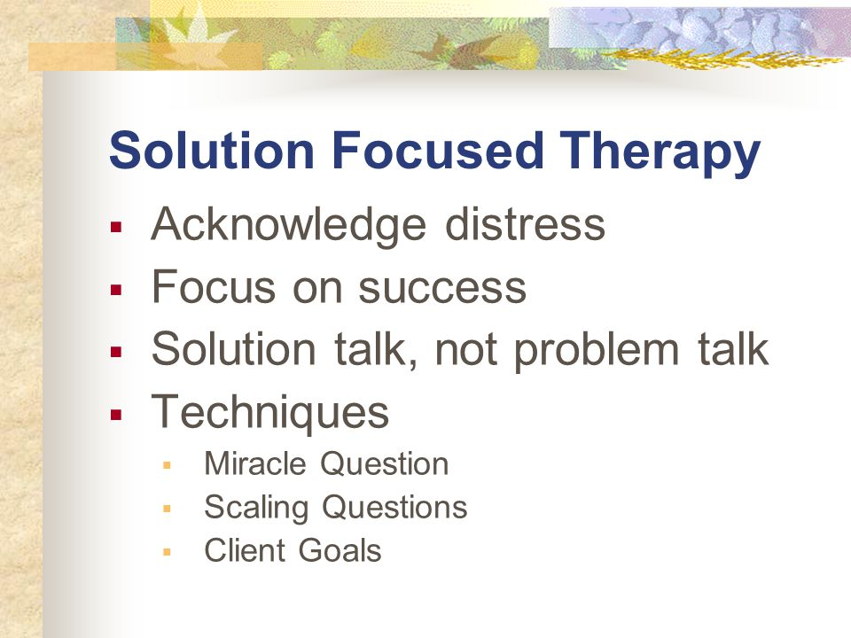

Slide 4
Strength finders
Strength finders is the best activity that can be used in the solution focus based therapy of a group of five grandparents trying to raise their grand children because their children are drug addicts. The activity of strength finders can help the five individuals to find a proper way of raising their grand children by finding their strength and motivation that makes them achieve the best.

Slide 5
The progress made in the therapy
The progress of the therapy was established by how the description of the feeling of the grandchildren they were supporting . Most of them felt that they were doing the right thing for the better future of their grandchildren. They did not feel stressed in helping the grandchildren to have a successful future. The progress was also measured by the consistence in the attending of the therapy sections, since they attended most of the section. The confidence , motivation and hopefulness of the grandparents in raising their grandchildren helped to show the progress they had undertaken in the therapy.

Slide 6
The material used in the strength finders activity
Materials that will be used in strength finding activities will be papers for questionnaire . They will be used to help the five grandparents to identify their strength in through the guidance of the questions. Pens used for writing the answers . Other activity to find the strength of the grandparents will be through games in that every patient will lead a group in doing a simple game .

Slide 7
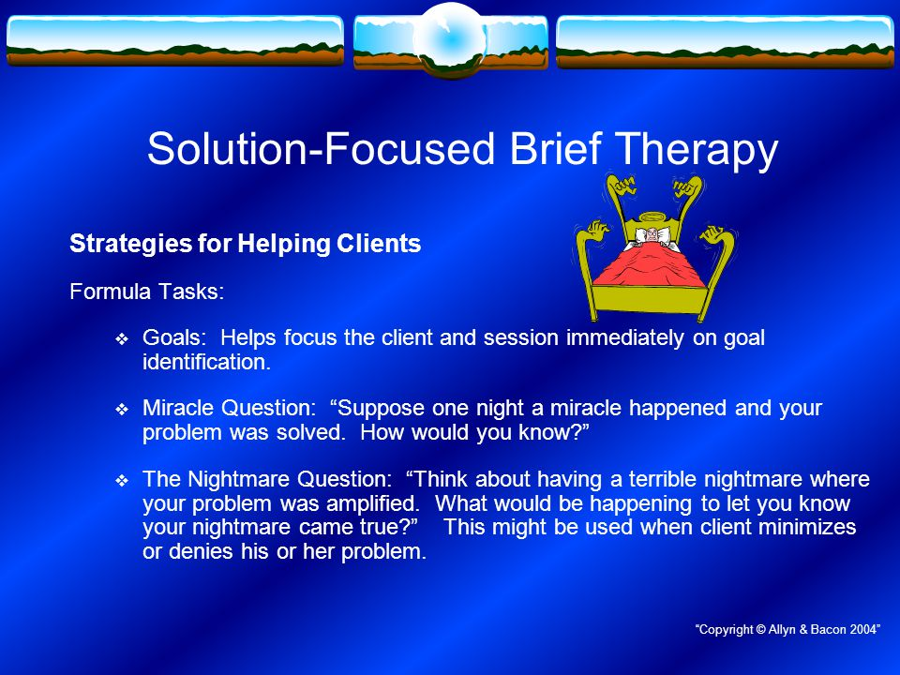

Slide 8
The purpose of the activity
The strength finder activity such as filling the questionnaires helps the patients realize what they are good in or not. This helps the therapists to identify strength other strength of the patients that may not come under the normal therapy sections. The strength found can help to identify ways for achieving their visions..

Slide 9
The purpose of the activity
Allowing the patients lead others in simple games help the therapist identify the strength of the patients which can be used to encourage them when they are giving up. Leading other people for a small exercise needs, patient , creativity ,courage and passion , this attribute when identified can be used to help the grandparents raise their grandchildren without more trouble.

Slide 10
The time frame of the activities.
Answering questionnaires can take three to five minutes, the questionnaires should be short and precise enable the grandparents to answer fast without problems. Every individual in the group leading the group in a simple exercise will take twenty minutes which can be as a break and bonding section .

Slide 11
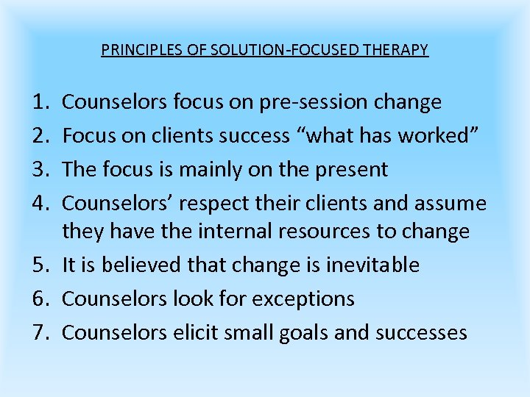

Slide 12
Activity discussion
Strength finders activities such as answering the questionnaire is very important in the solution focused based therapy because they help to measure the progress of the patients. If the grandparents were unhappy with raising their grandchildren and in the questionnaire they like parts of things the children do it is a progress that can be worked on. They help to find motivation and level of confidence of the patients.

Slide 13
Activity discussion
Strength finders activity can also be carried out in solution focus based therapy by allowing the patients for therapist lead others in a set of small exercise such as singing or stretching. It helps the therapist and the individuals to realize their capabilities and talents which can be a tool for working on the goals of the patients. It also helps the group to bond so that they don’t fear when they talk in the therapy sections.

Slide 14
Measure of the progress of the individuals
The measure of the progress in the solution focus based therapist is the level of confidence of the patients in succeeding . The level of hopefulness and motivation in achieving the goals sets .
Problem solving
Think on the solution of your problems | How do you feel while helping your grandchildren | Do you feel you can give your grandchildren better lives despite failing on your own children | Do you think your grandchildren have a promising future | What are you going to do to help your grandchildren

